Slide 1
Work plans for impact
Virtual regional training & peer-exchange on 2021 work plans. December 2020

Slide 2
Agenda
Introduction
Work plan objectives and national priorities
Systematic disclosure and Contract Transparency steps in workplans
Peer experiences
Developing work plans with country sensitive MEL framework
Questions and answers

Slide 3
Work plan objectives and national priorities
Work plan demonstrates why EITI is useful in your country
Why is EITI relevant today?
How is it contributing to national objectives?
How is EITI contributing to key stakeholder’s expectations?
Notes:
https://www.flickr.com/photos/eiti/48980506326/in/album-72157711550422386/
45th EITI Board meeting
Minister Samuel Urkato welcoming stakeholders
What is Helen going to tweet?
Christina

Slide 4
Making the case for EITI: connecting to national priorities
Trinidad and Tobago: Vision 2030
The public service will have modern, effective and efficient management systems. (Vision 2030, Theme II, Goal 2)
Suriname: Policy Development Plan
The central and local governments ensure that both the large-scale and the small-scale gold mining, which almost exclusively produces for export, have an as high as possible “retention percentage”, plan with the companies in the gold sector the reduction of environmental and social damage, and guaranty, partly on the basis of the adjusted statutory regulations, sustainable management of the earnings from the gold sector (Section VI.2.1).
Guyana: National Development Strategy
Despite the decline of the bauxite industry, mineral development has the potential to once again become an engine for economic growth in Guyana. The NDS makes several recommendations to deal with the constraints experienced in all subsectors of mining, and to ensure the continued growth of the mining sector as a whole:
the enhancement of the mining policy so that it embraces a fiscal regime, marketing arrangements, policies on technology, security of titles, training, the environment, and an approach to social issues in mining communities
Notes:
Ian said something interesting at the implementing country constituency meeting: the funding should come from government, because the case for mainstreaming is much easier to make. Also, if funding comes from government, then the case needs to be made much more strongly from

Slide 5
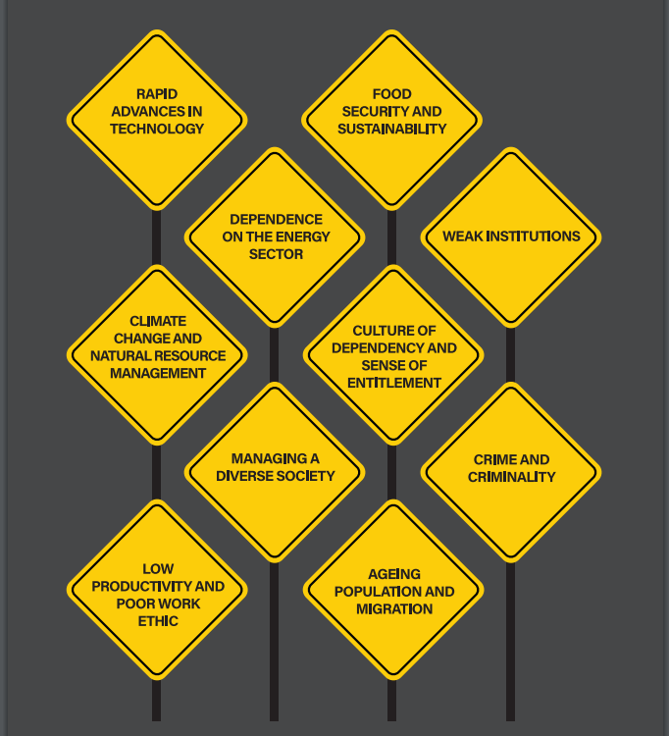
National priorities are also citizens’ priorities
Doesn’t only need to be from government.
What are citizens most concerned about?
What are companies most concerned about?
Public concerns change – EITI objectives can and should change to inform public debate
Work plans is a working document. Needs MSG agreement, but can be changed at any time.
Trinidad and Tobago, Vision 2030

Slide 6
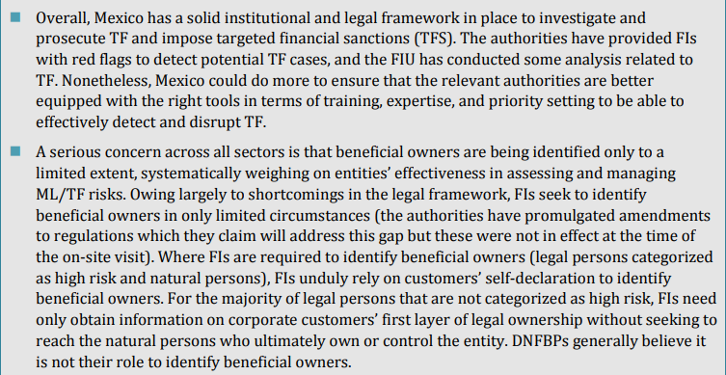
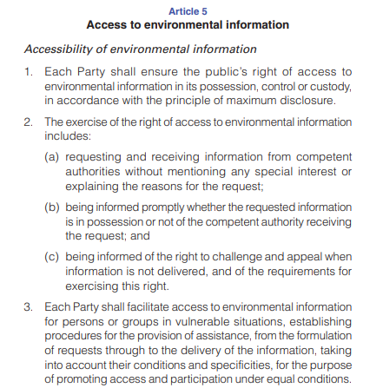
National priorities in other documents
Notes:
Goal of the EITI make it accesible and work with the institutions.

Slide 7
National priorities address problems
An exercise with all stakeholders in Dominican Republic raised these challenges
Obsolete legal framework
Weak public surveillance
Lack of knowledge on extractive activities
Opacity on resource use
Limited state capacity in contract negotiation
Lack of observation of contract clauses
Mistrust and opposition to extractive projects

Slide 8
Possible EITI objectives
Improve governance
Issue recommendations from the review of law and practice of oil, gas and mining. Improvements to legal framework & oversight of sector.
Improve public financial management
Recommendations to tax authority on lessons learned from EITI reporting – how can improve tax and non-tax collection and allocation?
Oversight of improvements to geo-mapping
Explore with reporting entities if payments data can be published in real time, or quarterly, per company (and project).
Notes:
Requirement 2, requirement 7, requirement 4

Slide 9
EITI objectives
Gauge environmental impact
Review environmental standards, rules and practice in EI. Issue recommendations on improving and aligning with international standards.
Improve public understanding of EI
Brief parliamentarians on key issues of EI: current status, functioning, challenges and improvements
Oversight of actions taken on reduction of impacts of oil
Present key contributions and challenges of EI sector, how these are being addressed. Engage with reporting entities. Regular oversight report on progress.
Notes:
Environmental reporting, oversight
Communicating results, building accountability

Slide 10
EITI objectives
EI’s contribution to the energy transition
Identify what elements of mining most relevant for plans to energy transition
Considering citizens’ concerns, and women in particular
Engage with CSO to identify most burning issues on EI that affects their well being.
Identify, with existing organisations, the issues from EI that affect women’s well-being most
Ensure women’s representation on MSG
Engage with stakeholders in area of energy transition to identify EITI’s contribution to ongoing work streams

Slide 11
How do we link?
Example
A narrative connects:
National priorities < as listed in strategy XYZ > are < X Y Z>.
As you can see in this work plan, the EITI’s activities contribute to achieving national goals, in particular:
Collection of revenue and production data supports tax collecting entities in ensuring that the right amount was paid, thereby strengthening existing tax collection and administration
Supporting < agency XYZ> in collecting and publishing beneficial owners and PEPs support existing efforts to target conflict of interest and breaches of laws. It can also support tax collection agencies in identifying potential red flags of tax avoidance.
EITI will survey current environmental standards that are applicable in mining sector and review if involved entities are complying.
Building capacity of parliamentarians: EITI has a working group that briefs parliamentarians on specific topics which are of particular interest. Also on demand.

Slide 12
2019-2020 T&T Workplan: 7 objectives
Integrate the EITI into Government Systems.
Guarantee High-level Stakeholder Buy-in for Greater Impact.
Getting more companies on board.
Embedding a culture of transparency through EITI legislation
Galvanising Civil Society and the Public on Sector Issues
Innovate how TTEITI reports.
Strengthen the National Secretariat.

Slide 13
Including activities on systematic disclosure

Slide 14
Not a new idea: Systematic Disclosure at heart of EITI mission
2005: Report of the International Advisory Group
“It was recognised that an international structure was required to channel advice and financial support and to exchange lessons learnt. However, such a structure should be light touch and designed with an eye on the ultimate goal for EITI to be ‘mainstreamed’, with its criteria and principles becoming the normal way of working in all the relevant extractive industries within three to five years”

Slide 15
From reporting to overseeing & strengthening
Systematic disclosure scenario:
EITI Board assesses between 3-36 months
MSG oversees routine disclosures – are in line with Standard?
analyses and communicates in line with EITI objectives
Summary reports, recommendations, briefs
Contracts
Licenses
Revenues
Legal and beneficial owners
Information is published more timely by entities themselves – on government and company websites, in the public domain.
MSG defines in work plan what national priorities to contribute to; defines how to achieve outcome
Notes:
This might be too complicated

Slide 16
Means: more engagement with others
Less reporting to EITI
More direct publication by reporting entities, engagement with EITI or other bodies on how to improve, exploring ways to publish routinely
In work plan: Actions are carried out with others

Slide 17
Expectation on work plan
By end 2018, all implementing countries are expected to develop a costed work plan for 2019 and onwards that includes steps to mainstream EITI implementation in company and government systems within 3-5 years.
12.02.2018, Decision 2018-08/BM-39: https://eiti.org/board-decision/2018-08
These are not sytematic disclosure activities
Building an EITI e-reporting portal.
Building an EITI open data portal / EITI data dashboard
You don’t need to do everything at once.
Work with reporting agencies. They publish, EITI oversees, collates, explains.
Notes:
Building an EITI e-reporting portal.
That can improve quality of EITI reporting data and improve efficiency of EITI reporting, but does not embed transparency at reporting entity.
Building an EITI open data portal / EITI data dashboard
Such measures can be a bridge or bring together data that is scattered across websites. Not neccessary to be branded with EITI. Goal is to make transparency the rule at the level of reporting agency.
EITI can play a crucial role of assessing quality, adherence to rules and narrative to the information.

Slide 18
Systematic disclosure activities
Stock take: what information is routinely available? What quality? Regular, comprehensive? Work with reporting entities! Statistics office, Ministry of Mines and Petroleum, Tax authority / treasury, commercial register, companies, SOEs, SAIs, … Checklist: https://eiti.org/document/systematic-disclosure-toolkit
Identify areas of particular high interest to stakeholders and focus on regular, public disclosures → more impact
For example, if there is high public interest (from companies, government and civil society) for combatting tax evasion, due diligence with business partners and PEPs holding EI licenses, then prioritise mainstreaming legal and beneficial ownership publication.
Identify the relevant reporting agencies. Mainstreaming activities must be done with reporting entities. Otherwise it’s not mainstreaming

Slide 19
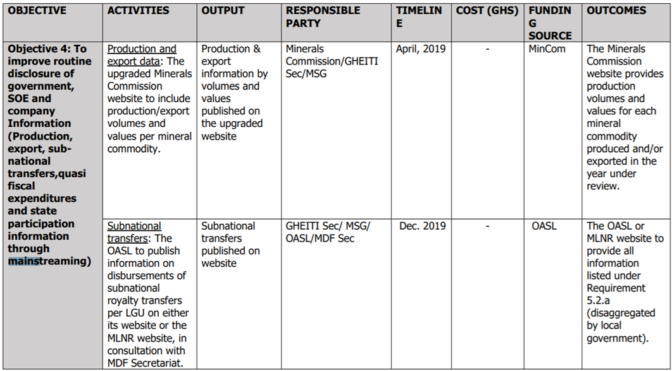
Ghana mainstreaming activities
Notes:
2020 work plan: here the focus is on following up with reporting agency on their routine disclosures, underpinned by their disclosure policy. Defines minium publication criteria.

Slide 20
Including steps on contract transparency

Slide 21
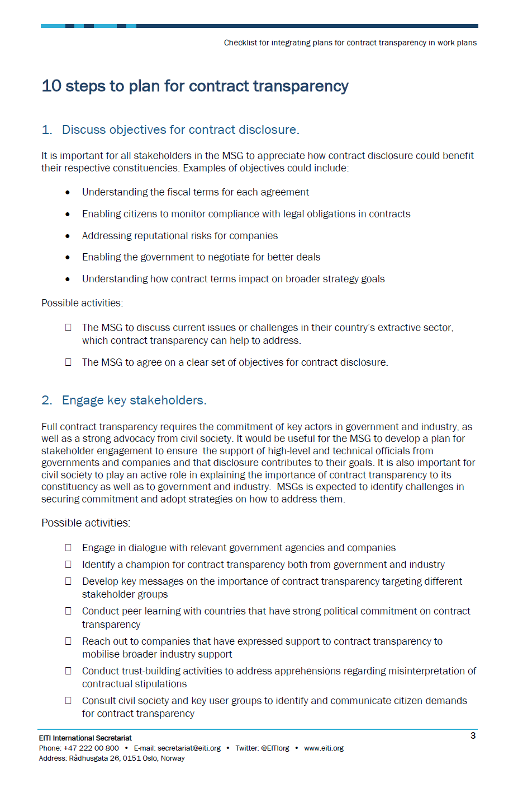
Including contract disclosure
The 2019 EITI Standard
Disclose any contracts and licenses that are granted, entered into or amended after 1 January 2021.
Document the government’s policy on disclosure of contracts and licenses that govern the exploration and exploitation of oil, gas and minerals.
Encourage to do this in mainstreamed approach: publication through responsible government agency. EITI reporting evaluates comprehensiveness, access, etc
Checklist from 2019
Activities to include in your work plan on contracts
Sent via NSC:
https://eiti.org/files/documents/contract_transparency_checklist_2.pdf

Slide 22
10 steps – do not need to be consecutive
Discuss objectives for contract disclosure.
Engage key stakeholders.
Secure or produce a list of all active extractive contracts in your country, as well as potential contracts that would be entered into by 1 January 2021.
Understand the current state of your country’s contract disclosure practices and identify low hanging fruit.
5. Undertake a legal review and agree on recommendations for addressing legal barriers.
6. Agree on methods for disclosure
7. Conduct capacity building activities.
8. Actual disclosure.
9. Identify resources.
10. Determine a feasible timeline for all activities.

Slide 23
Peer experiences

Slide 24
Monitoring and evaluating progress

Slide 25
The EITI Standard – learn and adapt
Outcomes and impact
#7.3 and #7.4
Keeping track
Logging progress in logframe
Carry out WP. Collect indicator data on the go
Review progress
Adjust WP and agree on objectives
Work plan: objectives, actions
Analyse and (work) plan
Why? How? Who?
ToC, stakeholder mapping
Reflect Did we manage?
Is it useful?
Did it work / lead to expected outcome? Why, why not?
Did priorities change? Expectations change
Work plan
#1.5
Update, review and adjust to new setting.

Slide 26
Objectives
Objective
Outcome 1 and 2
Action 1, action 2, action 3, action 4, action 5, action 6
Outputs 1, 2, 3
What the aim and goal is
Has link to national priority
To achieve objective, need several outcomes.
Outcomes is what EITI can influence directly
One outcome is achieved through a collection of outputs
To get outputs, you need activities
To carry those out, you need to be resourced (input).
Inputs – from MSG, national Secretariat, reporting entities (their time reporting and reviewing disclosures), oversight institutions, development partners, int. Secretariat support, Independent Administrator…

Slide 27
Building a work plan for monitoring impact
To show impact, you need to show outcomes
SMART objectives and activities
Specific, Measurable, Achievable, Relevant, Time-bound
If specific and measurable, then you can define and track success, impact
Work plan: specific about resource needs, commitment to what, when and who. Basic accountability tool.
Monitor: measure regularly.
Evaluate: Did we meet the benchmark?
Learn: Why did we achieve what we wanted to? Why didn’t we for other outcomes? → helps adapt, improve over time
Monitoring, evaluation and learning framework: track indicators over time, accountability towards MSG, reporting entities, the public and government. Data driven, impartial, evidence
Notes:
MEL over a longer period of time. Not just one year.

Slide 28
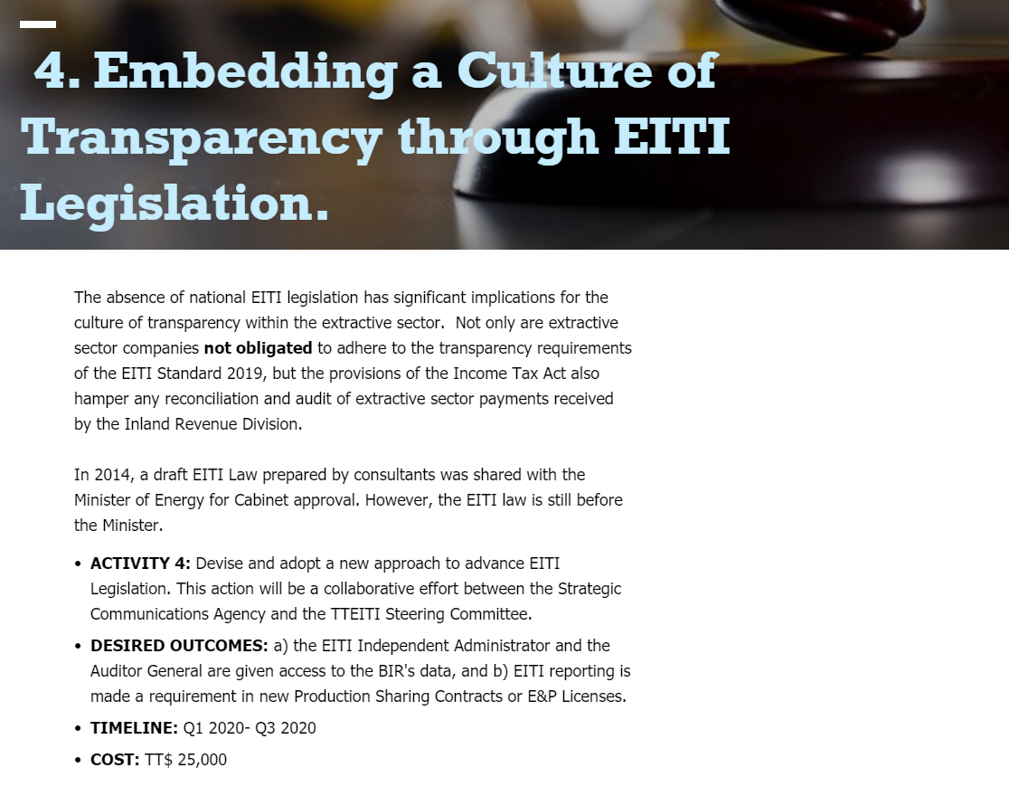
SMART design
Objective
Specific, Measurable, Achievable, Relevant, Time-bound
How achieve objectives?
Split into activities that have clear outcomes, measurable, costed.
Example T&T
T&T providing objective, rationale, activity, outcomes, time, cost.
Clearly written
Indicate responsible person / entity for action
Rationale
Activity

Slide 29
How work plan relates to MEL
Measurement / log frame
Work plan
Inputs | Activities | Outputs | Outcomes
Sec staff Stakeholder meetings
 | Output | Descr | Indicator | Method | Q1. Q2 etc
Outcome 1
Outcome 2
Outcome 3

Slide 30
Tracking progress – detailed log frame
 | Outputs | Description | Indicators |  |  | Method | Q1 | Q2 | Q3
 |  |  | Indicator | Baseline | Endline target
1 | Outcome #1 |  |  |  |  |  | Target: Realized: | Target: Realized: | Target: Realized:
 | Output #1 |  |  |  |  |  | Target: Realized: | Target: Realized: | Target: Realized:
 | Output #2 |  |  |  |  |  | Target: Realized: | Target: Realized: | Target: Realized:
 | Output #3 |  |  |  |  |  | Target: Realized: | Target: Realized: | Target: Realized:
 | Output #4 |  |  |  |  |  | Target: Realized: | Target: Realized: | Target: Realized:
2 | Outcome #2 |  |  |  |  |  | Target: Realized: | Target: Realized: | Target: Realized:
 | Output #1 |  |  |  |  |  | Target: Realized: | Target: Realized: | Target: Realized:
 | Output #2 |  |  |  |  |  | Target: Realized: | Target: Realized: | Target: Realized:
 | Output #3 |  |  |  |  |  | Target: Realized: | Target: Realized: | Target: Realized:
 | Output #4 |  |  |  |  |  | Target: Realized: | Target: Realized: | Target: Realized:
3 | Outcome #3 |  |  |  |  |  | Target: Realized: | Target: Realized: | Target: Realized:
 | Output #1 |  |  |  |  |  | Target: Realized: | Target: Realized: | Target: Realized:
 | Output #2 |  |  |  |  |  | Target: Realized: | Target: Realized: | Target: Realized:
 | Output #3 |  |  |  |  |  | Target: Realized: | Target: Realized: | Target: Realized:
 | Output #4 |  |  |  |  |  | Target: Realized: | Target: Realized: | Target: Realized:
Notes:
https://extractives.sharepoint.com/:x:/r/sites/ImpactassessmentEITI/_layouts/15/Doc.aspx?sourcedoc=%7B22A3104A-7E20-44BB-958F-29984D25A113%7D&file=MEL%20Tracker%20for%20Lift.xlsx&action=default&mobileredirect=true

Slide 31
Beyond the log frame
Log frame is for data collection
Progress reporting based on facts / data (log frame) but can allow for broader reflections:
How did context change? Political change, regulatory change etc
Stakeholder mapping: new people / actors that need to be consulted?
Are there enough resources?
What didn’t work? What work stream should be abondoned, what should be added? (→ feeds into work plan of the following year)
Is our theory of change still right?
Communicate impact: narrative on what goals have been met

Slide 32
Let’s break this down
Goal: Timely information on company payments that actually went to the Treasury (and to MoE – who issue project-level invoices) are known to all stakeholders with a delay of 1Q+1 month.
Be specific - SMART
Ensure that payments by companies which contributed to more than 5% of revenues last year publicly available online (at Treasury website and Ministry of Mines for non-tax / published by companies themselves) no later than 3 months after the end of each financial year.

Slide 33
Logframe
Outputs | Description | Indicators |  |  | Method | Q1 | Q2 | Q3
 |  | Indicator | Baseline | Endline target
Outcome #1 | that payments by companies which contributed to more than 5% of revenues last year publicly available online (at Treasury website and Ministry of Mines for non-tax / published by companies themselves) on quarterly basis (Q+1Q). | # of companies that published revenues no later than 3 months after financial yr, accurate info. | 0 | 100% | Match materiality review of companies on yearly basis with published data on Ministry of Energy and Treasury. | Target: 0% Realized: | Target: 5% Realized: | Target: 10% Realized:

Slide 34
Logframe
Outputs | Description | Indicators |  |  | Method | Q1 | Q2 | Q3
 |  | Indicator | Baseline | Endline target
Output #1 | Govt ministries and companies are aware of expectation | % of stakeholders briefed |  |  | Briefing (virtual) meetings with all stakeholders | Target: Realized: | Target: Realized: | Target: Realized:
Output #2 | Working group established with Treasury, Ministry of Energy and Nat. Sec /MSG | MoU for working together for more real time data publication | 0% | 100% | Agreement is in place, funding secured and MSG approved. | Target: Agreement in place Realized: | Target: 0% Realized: | Target: 50% Realized:
Output #3 | Data collection for tax and non-tax revenue with new method is agreed | Final report | 0% | 100% | IA, IT specialist from treasury and Minstry of Energy, Nat Sec develop options. | Target: Draft Realized: | Target: updated draft Realized: | Target:Final Realized:
Output #4 | Companies have reviewed and provided feedback on reporting method | % of companies reviewed and given feedback | 0% | 80% | Delivered workshops and survey result. Review of feedback of companies | Target: Realized: | Target: Realized: | Target: Realized:

Slide 35
Guidance from GIZ
In particular section 8
https://eiti.org/document/giz-monitoring-evaluation-me-of-eiti-implementation
EITI Int Secretariat to review guidance notes and materials on work plans, progress reporting and MEL.

Slide 36
Questions and Answers
Updates from countries on work plan preparation activities and questions on M&E

Slide 37
AUTHOR International Secretariat
DATE December 2020
OCCASION Work Plans. LAC.
E-MAIL secretariat@eiti.org PHONE +47 22 20 08 00
ADDRESS EITI International Secretariat, Rådhusgata 26, 0151 Oslo, Norway

