Slide 1
TTEITI Workplan Approach Presented by- Oji Borel policy analyst

Slide 2
Agenda
TTEITI Approach
Survey Results
Review Previous Work Plan
TTEITI Strategy Retreat
Next Steps

Slide 3
Survey
Previous Work Plan review
Work Plan
Strategy Retreat
Notes:
Workpalns standard 1.5 - EITI implementation objectives that are linked to the EITI Principles and reflect national priorities for the extractive industries
Survey sent to MSG and external stakeholders
Review conducted on previous work plan
Members of MSG participated in brain storming strategy sessions
EITI guidelines
Move to workplan 2 to 3 years

Slide 4
Survey Results

Slide 5
Survey Results
Notes:
This information was incorporated to our key Strategic focus areas

Slide 6
Previous Workplan Review
Mining Sector Reporting
High level Buy-in
Legislative Change
Report Innovation
Progress in Mainstreaming
Secretariat Empowerment
Public outreach
SHORTCOMINGS
SUCCESS
Notes:
The review of the 2019 – 2020 workplan revealed our areas where we had success
It also showed our short comings
Those areas would be carried forward to the new workplan

Slide 7
TTEITI Strategy Retreat
Blue sky session
Brainstorming
Notes:
Members from the Multi Stakeholder group were invited.
Two sessions were done and was hosted by our chairman Mr. Gregory McGuire

Slide 8
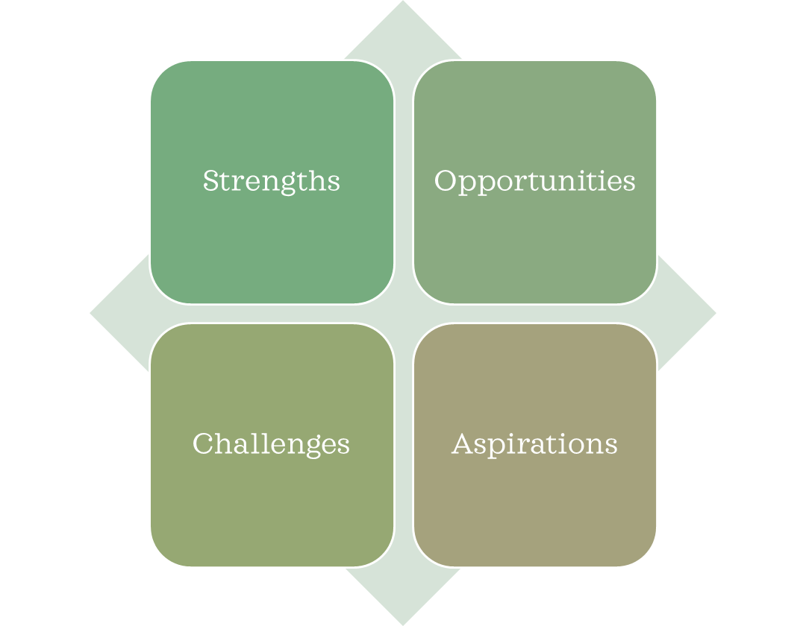
SOCA
Strategic Priorities
Mainstreaming
Public Awareness
Legislative Change
Mining Sector Participation
Environmental Reporting and Impact
Notes:
Tools we used SOCA adapted from SOAR analysis
We then determined our strategic priorities
Challenges – Weak regulatory framework in the mining sector
Opportunity – Digitization
New workplan would better address how we measure impact

Slide 9
Next Steps
Participants from TTEITI BlueSky session to provide additional feedback
Workplan strategy to be presented to Steering Committee
Steering Committee provide feedback
SC approves workplan

Slide 10
Thank You

